Slide 1
JavaScript basics
Getting started with JavaScript

Slide 2
What is JavaScript, really?
JavaScript ("JS" for short) is a full-fledged dynamic programming language that, when applied to an HTML document, can provide dynamic interactivity on websites. It was invented by Brendan Eich, co-founder of the Mozilla project, the Mozilla Foundation, and the Mozilla Corporation.
Developers have written a large variety of tools on top of the core JavaScript language. These include:
Browser Application Programming Interfaces (APIs) — APIs built into web browsers, providing functionality like dynamically creating HTML and setting CSS styles, collecting and manipulating a video stream from the user's webcam, or generating 3D graphics and audio samples.
Third-party APIs to allow developers to incorporate functionality in their sites from other content providers, such as Twitter or Facebook.
Third-party frameworks and libraries you can apply to your HTML to allow you to rapidly build up sites and applications.

Slide 3
JavaScript Key Characteristics
JavaScript is a lightweight, interpreted programming language.
Designed for creating network-centric applications.
Complementary to and integrated with Java.
Complementary to and integrated with HTML.
Open and cross-platform.
Client-side JavaScript is the most common form of the language. The script should be included in or referenced by an HTML document for the code to be interpreted by the browser.

Slide 4
Advantages of JavaScript
Less server interaction: You can validate user input before sending the page off to the server. This saves server traffic, which means less load on your server.
Immediate feedback to the visitors: They don't have to wait for a page reload to see if they have forgotten to enter something.
Increased interactivity: You can create interfaces that react when the user hovers over them with a mouse or activates them via the keyboard.
Richer interfaces: You can use JavaScript to include such items as drag and drop components and sliders to give a Rich Interface to your site visitors.

Slide 5
What can JavaScript do?
The core JavaScript language consists of some common programming features that allow you to do things like:
Store useful values inside variables. In the above example for instance, we ask for a new name to be entered then store that name in a variable called name.
Operations on pieces of text (known as "strings" in programming). In the above example we take the string "Player 1: " and join it to the name variable to create the complete text label, e.g. ''Player 1: Chris".
Running code in response to certain events occurring on a web page. We used a click event in our example above to detect when the button is clicked and then run the code that updates the text label.)
And much more!

Slide 6
JavaScript is not Java
The JavaScript resembles Java but does not have Java's static typing and strong type checking.
JavaScript supports most Java expression syntax and basic control-flow constructs.
JavaScript has a simple, instance-based object model that still provides significant capabilities.
Java is a compiled language whereas JavaScript is interpreted language (however JavaScript code for NodeJs can be compiled into executables).
JavaScript is mostly used for web development (however this has changed in recent times as now it is being used for all sorts of use cases), Java is a general purpose programming language that can used to develop all kind of applications.

Slide 7
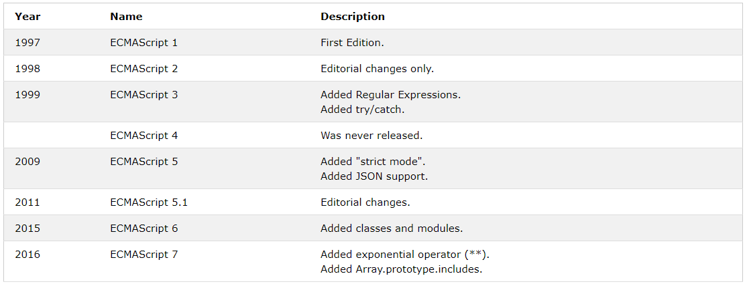
JavaScript history

Slide 8
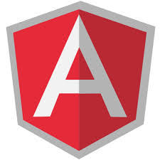





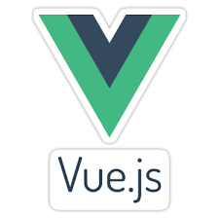
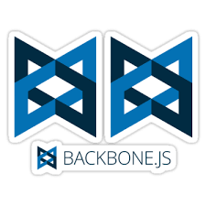


JavaScript Today
In Browser
Web Server/Process

